Slide 1
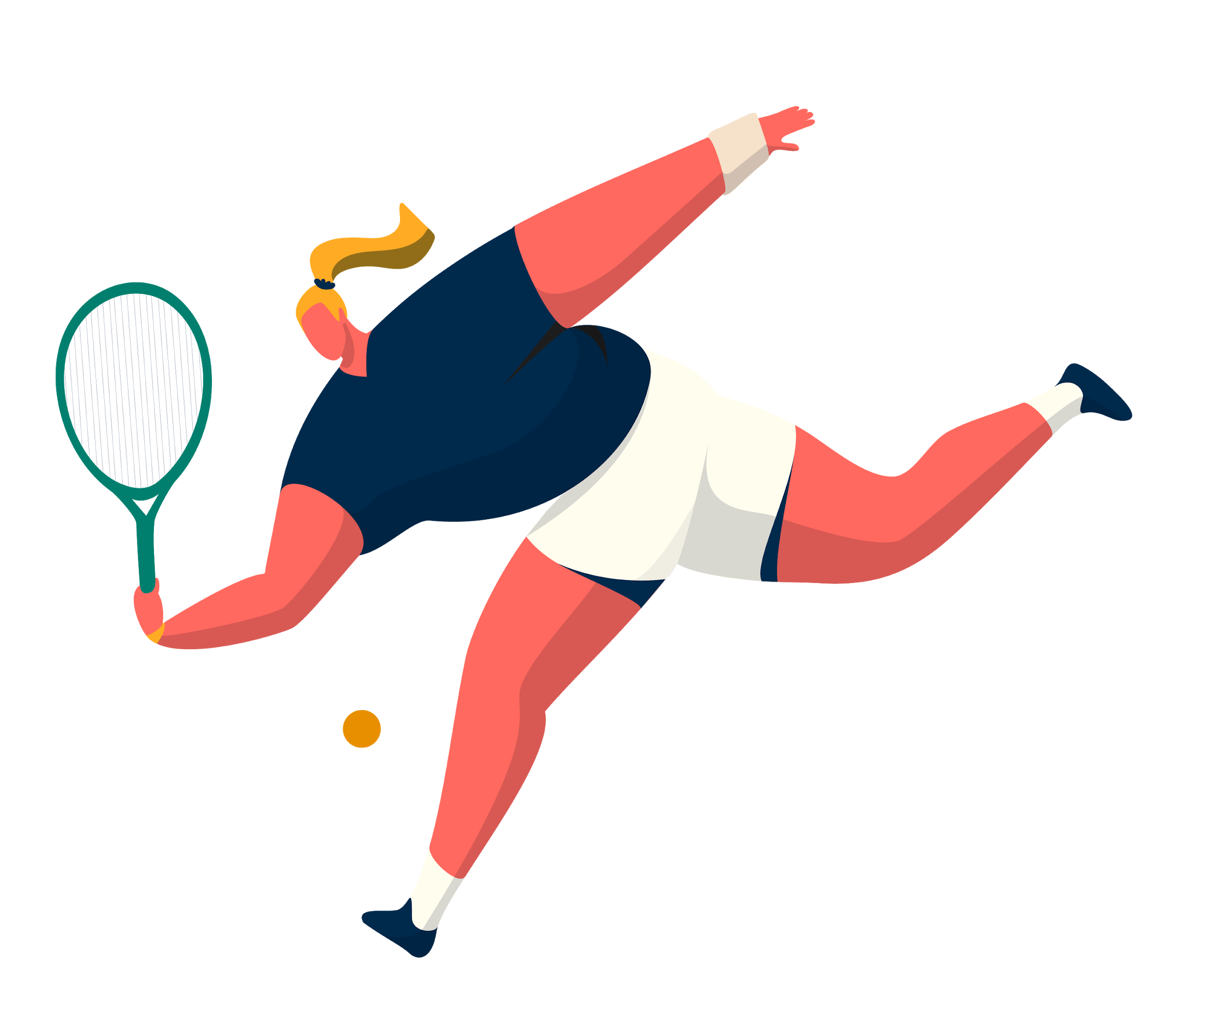
PHYSICAL EDUCATION AT ELEMENTARY SCHOOLS
(G)Anna Serdyukova
Notes:
I was interested in PE which is what made me choose this topic

Slide 2
Inquiry Question
What are the positive effects of Physical Education and how can it be integrated into different subjects?
Notes:
-curious about phys ed in schools and came up with this

Slide 3
CORE COMPETENCY
SUB-COMPETENCY
Core Competency Connection
ELABORATION
CONNECTION
Exploring and Enhancing Pedagogy
Demonstrate a deep
understanding of overarching
disciplinary concepts
This competency is about having
a deep, all around understanding
of curricula and make explicit
multidisciplinary connections to
promote life-long learning
Physical Education and
overarching disciplinaries
Notes:
The core competency>>Sub competency>>
What this means?
Connects with my inquiry and I wanted to explore different ways to incorporate PE to all subjects

Slide 4
Amount of time spent doing PE
Elementary School
Middle School
Highschool
15 minutes – 120 minutes
per week*
60-150 minutes per
week*
60 – 150+ minutes per
week*
*Can vary
Notes:
First I looked into amount spent
These are my own findings, got it from speaking to teacher and personal experience
Elem. depends on the teacher
Middle school more emphasized
Highschool you can personalize learning
Can take more PE classes or go into program

Slide 5
Recommended amount of time for PE
Elementary School
Middle School
Highschool
150+ minutes per week
150+ minutes per week
225+ minutes per week
Notes:
Found the actual statistics of the recommended amount of PA in school
PICTURE: recommends 60 minutes PER DAY of moderate to vigorous activity for everyone
These vary, some said need 150 per school 10 days
ALOT LOWER IN REALITY
PICTURES:
http://clipart-library.com/clipart/Xdc4oXdTe.htm
https://csepguidelines.ca/children-and-youth-5-17/

Slide 6
Positive Effects of Physical Education
With quality Physical Education, what
are they?
Notes:
Then I looked into the positive effects
Lots of studies relating to this
Many people want to prove scientifically that PA is linked to MANY things

Slide 7
Bone health
Prevention of risk factors for diseases or conditions
Physical Positive Effects
Heart Health
Muscle Health
Physical Activities can put
force on bones that
promotes bone
growth and strength and
gain bone mass
Such as cardiovascular
disease and obesity
Activities to promote
healthy heart rates and
blood pressure
Physical Activities
strengthen muscles
Notes:
easiest to see positive effects physically
prevents diseases/conditions
promotes strong bones
promotes healthy heart
strengthens muscles

Slide 8
Self-esteem
Social development
Skills
Social Positive Effects
Self-esteem is improved
with physical activity
This includes
sportsmanship, teamwork,
life skills
Knowledge and skills that
are learned from Physical
Education to lead
physically active lifestyles
Notes:
PICTURE:
https://images.app.goo.gl/k7keVB2ZPi6fwrfg7
the "affective" part of PE
Self esteem improved
Socially improved, sportsmanship, teamwork, life skills
Skills used throughout life to promote healthy lifestyles

Slide 9
Physical activity association with cognitive function
Attention
Psychological health
Cognitive Positive Effects
Behavioral advantages
Academic performance
Life skills
Brain areas involved with
movement and learning are
intimately connected
Students more attentive
during class with more
Physical Education
Students are more self
-regulating and stress free
Students tend to have less
behavioral issues in the
classroom with PE
Enhancement in math,
acuity, and reaction time
due to stimulation of
prefrontal cortex
PE promotes life skills such
as boundaries and self
-regulation
Notes:
Days are more manageable when they practice PE

Slide 10
Integration
Notes:
Other subjects take up so much time and i was curious how to integrate PE

Slide 11
Math
English
Integration with other subjects
Science
Social Studies and Other
Geometric Shapes
Counting
Team Challenges
- Site words
Physics
Biology
- Salmon Run
- Drama Exercises
Notes:
Finding shapes outside, drawing them with chalk, jumping/hopping/skipping on certain ones
Counting swings, monkey bars, adding and subtracting them
Using math challenges in PE for teams, have to figure it out for points
Site words or letters on cones, rolling ball to cones<< WITNESSED
Physics: Relative distance in PE class
Biology: Going outside to search for different things such as worms, butterflies, etc
Social studies: Can imitate salmon run
Drama: anything with moving your body

Slide 12
Reward
Integration in other ways
Break
Other
Students get rewarded with game after long class
Physical Activity to get out energy
What else can you use it for?
Notes:
Reward: rewarding them with a game after a long class, kids feel as though there is some outcome after long class
Break: Yoga for mindfulness, helping them get energy out, change of scenery
allows non-academically minded children to succeed
kids that cant sit still could help>> will give them responsibility to go outside and have 2 minutes (FE) to run around but need to come back in 2 min or privileges are lost
Self-Regulation>> if kid knows they can’t concentrate, can say they need a 2 min running break
PICTURES:
Powerpoint Stock Images

Slide 13
Wednesday Visits
Amount of time for PE Reaction to time alloted
Talking to teachers Thoughts on PE
Change in Curriculum Seeing the difference in other classes
Outdoor Program inspiration Specific program leading to more PE opportunities
Notes:
Amount of time: I was very shocked, have been working with children for over 5 years and have never known actual time for PE classes in Elementary schools, only actual guidelines which are WAY off
Talking to teachers: the motivation to teach PE is down, very tough for elementary teachers to focus on all subjects perfectly, most believe academics more important
Change in curriculum: even though bc curriculum has changed, the way English, math, indigenous studies, more fluidity, but for PE, all that has changed is HEALTH and MENTAL WELL BEING being included, can’t find amount of time to spend for PE in curriculum website
Outdoor Program: Program is based outside a lot, allows for PA to be incorporated easily, this made me want to see how other classes that aren’t part of program can incorporate PA

Slide 14
Experience
Inquiry Development
Expectations
Personal Opinion
Reaction
Notes:
Reaction: Initially, this inquiry interested me because I was shocked about how little amount was spent doing PE which is something so important, especially with younger children
Personal opinion: I think healthy lifestyles aren’t promoted enough and should be taught early because it sets a baseline and generates understanding for life-long habits that are good
Experience: I have worked with children so many years and have always promoted PA, going into schools and experiencing it for myself showed the problems that could rise when teaching, not just for PE but all classes
Expectations: Honestly, I think in the beginning I was a little judgmental towards amount of PE in classes but now have realized that it’s a lot harder than it looks on paper to implement more PA, sometimes there is less time to do other work and you are more pressured to complete an (FE) English unit rather than a PE one. Lots of teachers haven’t had the right amount of schooling for PE and some don’t have an interest, how are you supposed to teach something that doesn’t connect with your life?

Slide 15
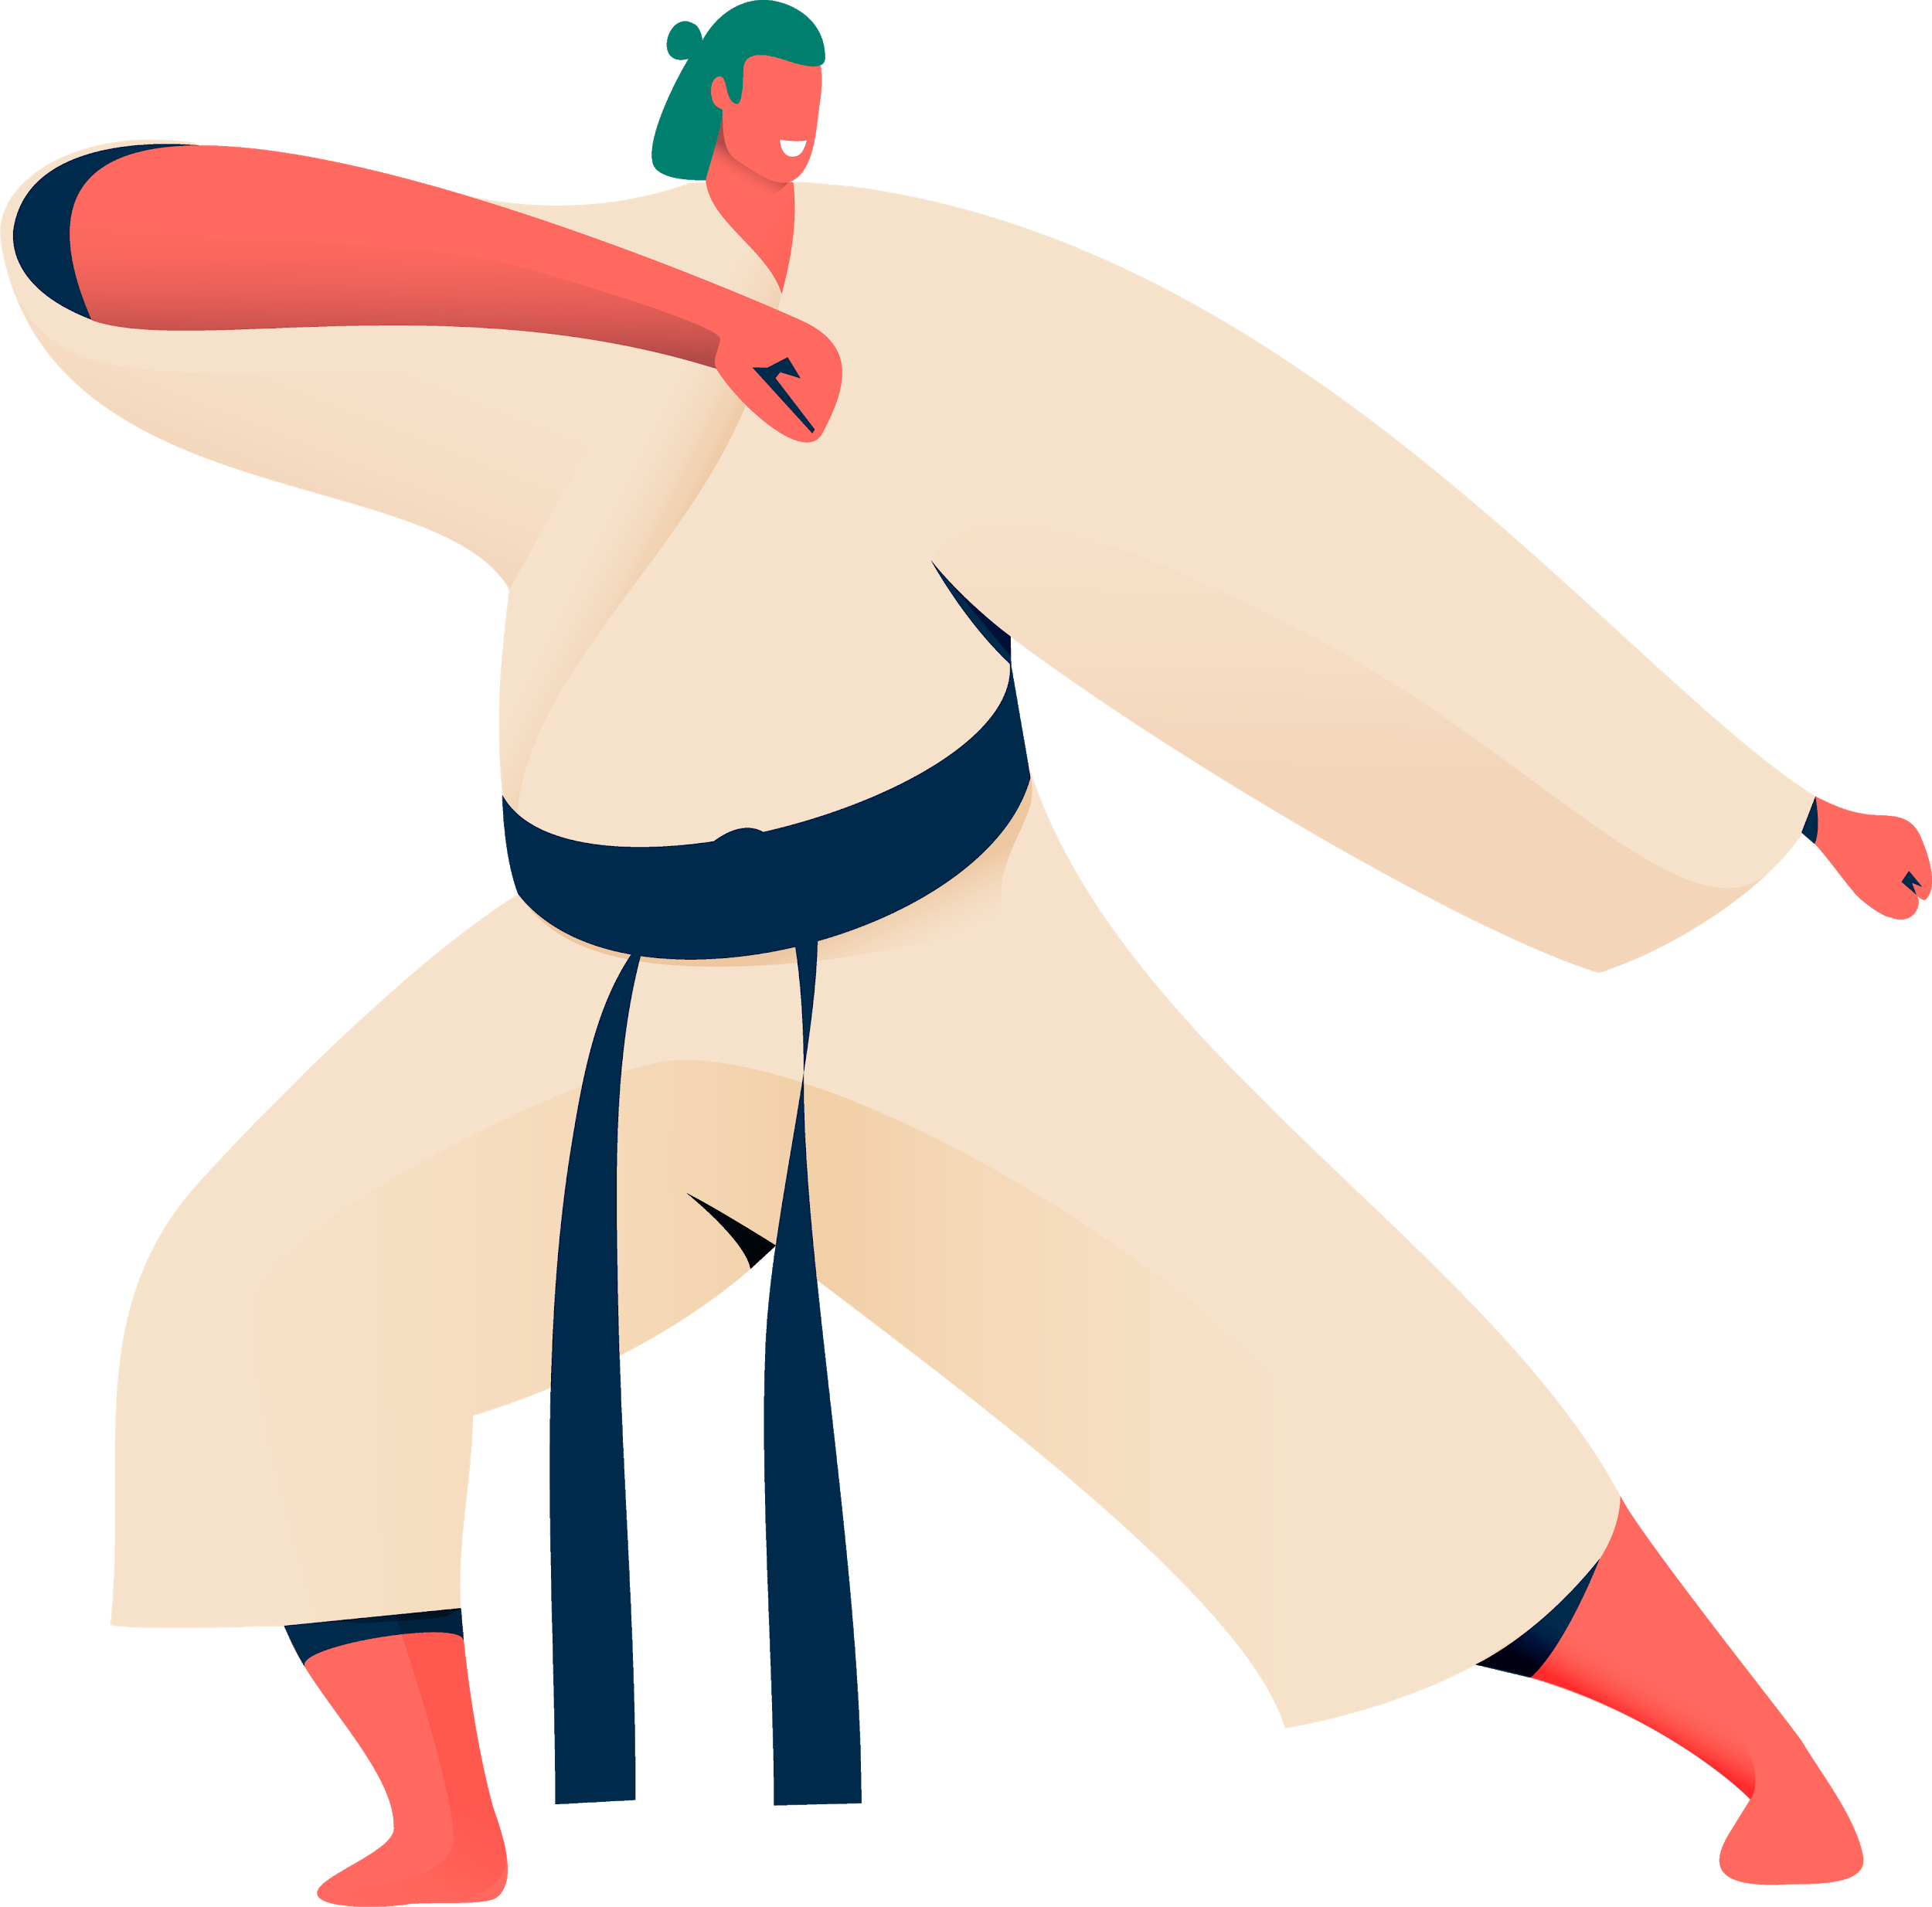
“Anything you may,
Nothing you must.”
—Phil Duchene (personal communication, October 30, 2020)
Notes:
This really spoke to me as I realized that even though elementary teachers teach ALL subjects, they cannot be perfect in every single one

Slide 16
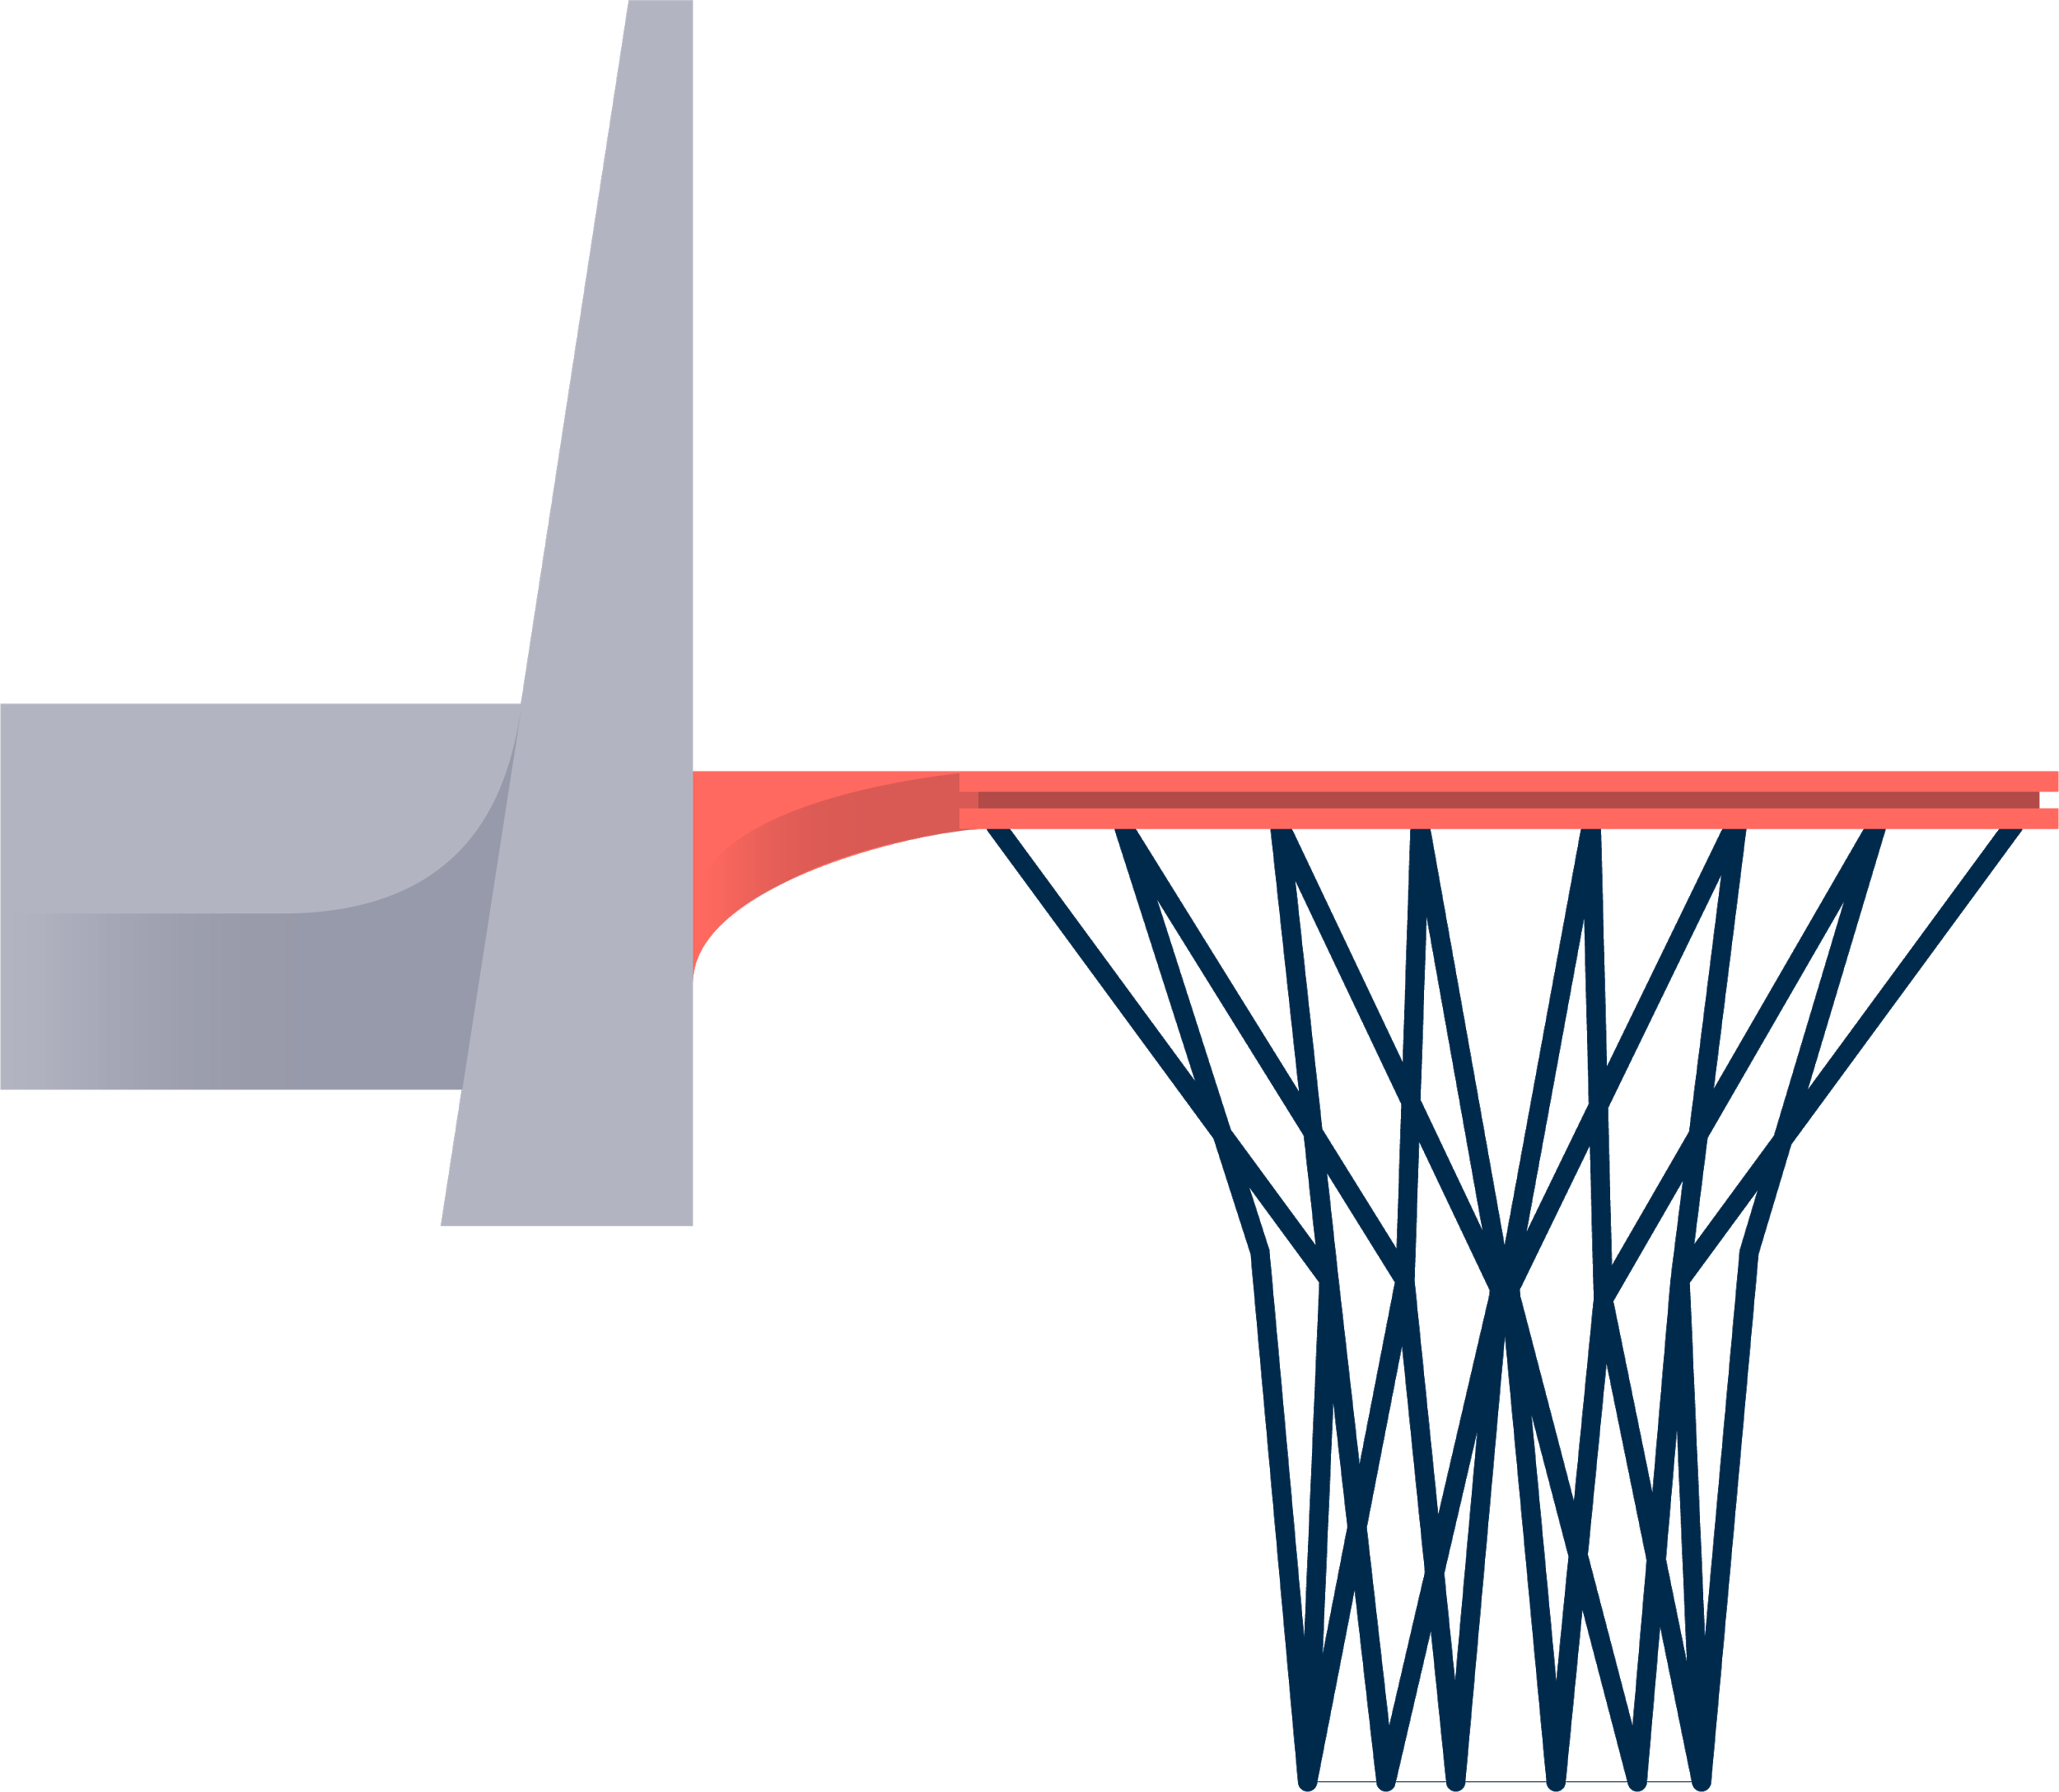
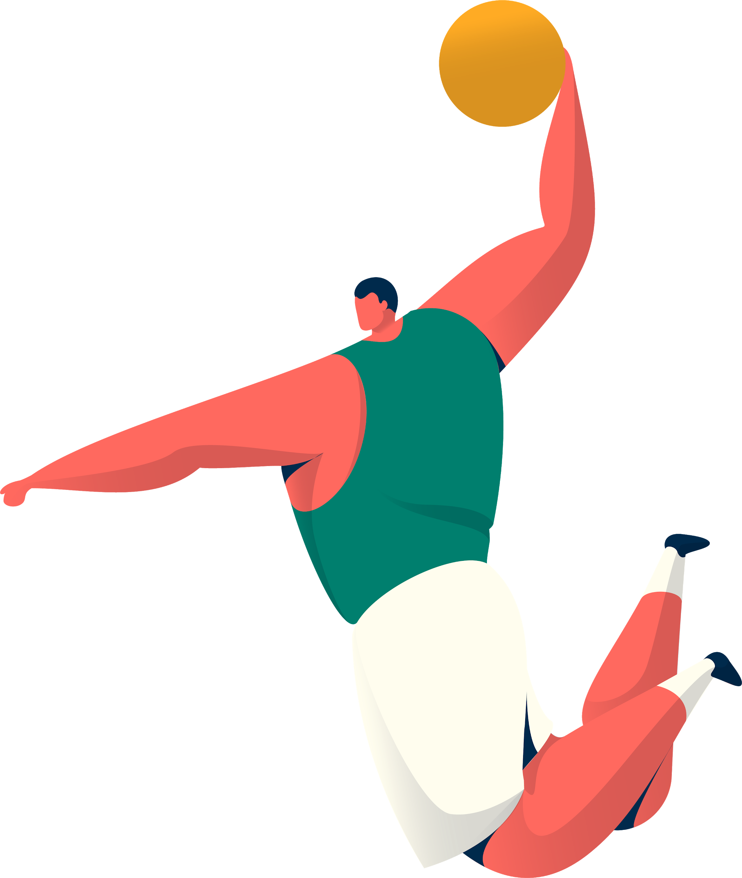
Overall Findings
Physical education has a big part in a child’s development,
It helps them physically, affectively, socially
Even though many studies only show a small correlation with improvement academically and physical activity, all results are still positive
Healthy lifestyles should be taught earlier in life to promote healthy habits and set a baseline for children in the future
Daily PA can help teachers in the long run as well
More pedagogy of physical education available for teachers should be a necessity
Notes:
Physical education needs to be emphasized starting in younger grades because it helps them in so many ways
Studies I have read have NO negative effects when more PE is included in the curriculum
Even some studies that take away time from other subjects show no decrease in academic ability in other subjects and have an increase in PA
PE promotes a baseline for life-long habits, will help children be more active in adulthood
NOT ONLY active, but healthy all around, mental health and proper diets, mood will also shoot up
All about applying yourself, PE need to be taught more to teachers and in depth as QUALITY PE is what gets results
Should have more available resources to teachers to allow for better learning about PE

Slide 17
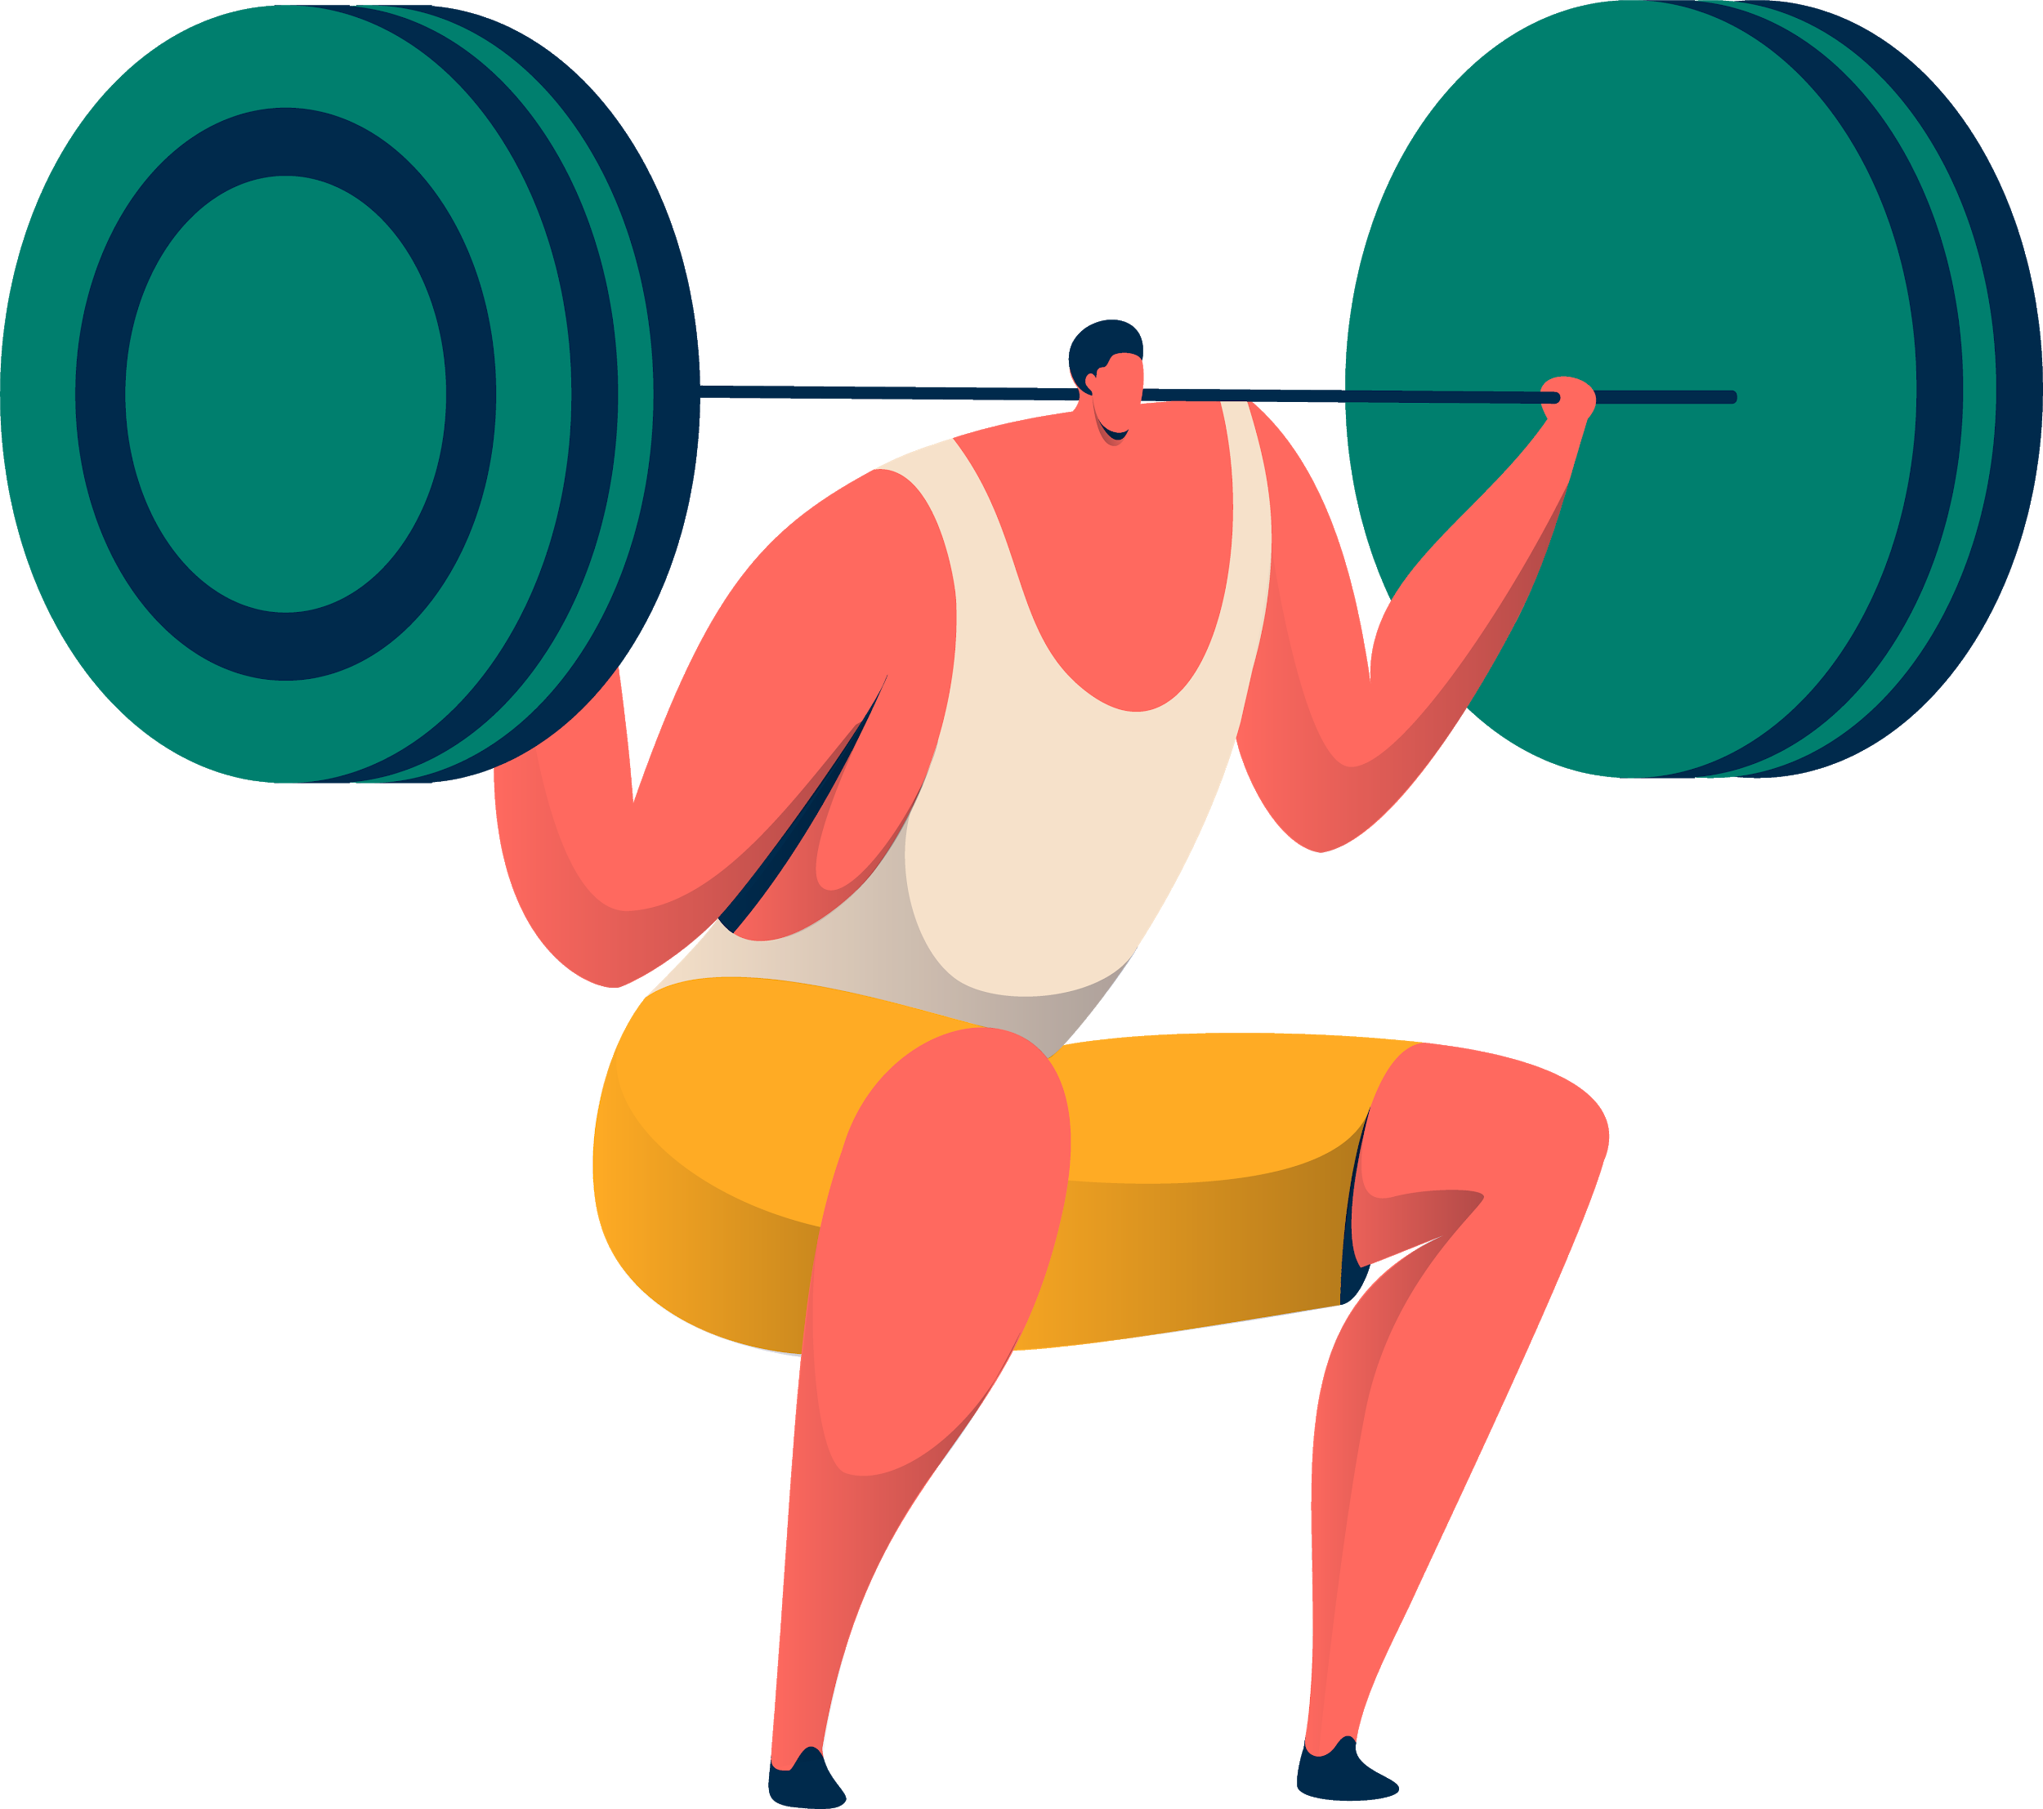
How to Incorporate
Teaching Career Relevance
Positive Effects
Teaching Style
Have learned so many different ways I can put PE into every lesson
Have learned how promoting PA every day has so many positive effects
Have learned that my teaching style can be a Physically Active one
Notes:
How to incorporate: In my teaching career, I have gotten so much insight that can be used in every lesson, not just ideas for lessons but how to move more in the classroom without a “gym time”
Positive effects: This will help my teaching career as I can understand how promoting PA and PE everyday can help in so many different ways, can pass on this information to other teachers if they are having problems in the classroom or need ideas to reward children
Teaching style: Because of how interested I am in this inquiry, from all of my findings, I will make my teaching style PA based, be a teacher whos’ students are usually moving around

Slide 18
Explore More
Statistics
Different Programs
Indigenous Learning
Notes:
Different programs: I’d like to look into what kind of programs there are out there that include more physical education, FE I didn’t know there were outdoor based classrooms
Statistics: I want to look into exactly what the statistics are with physical education In schools, I want to see whether there are different factors to why there is more PE in some schools than others
Indigenous learning: I would like to know how to incorporate indigenous learning into PE

Slide 19
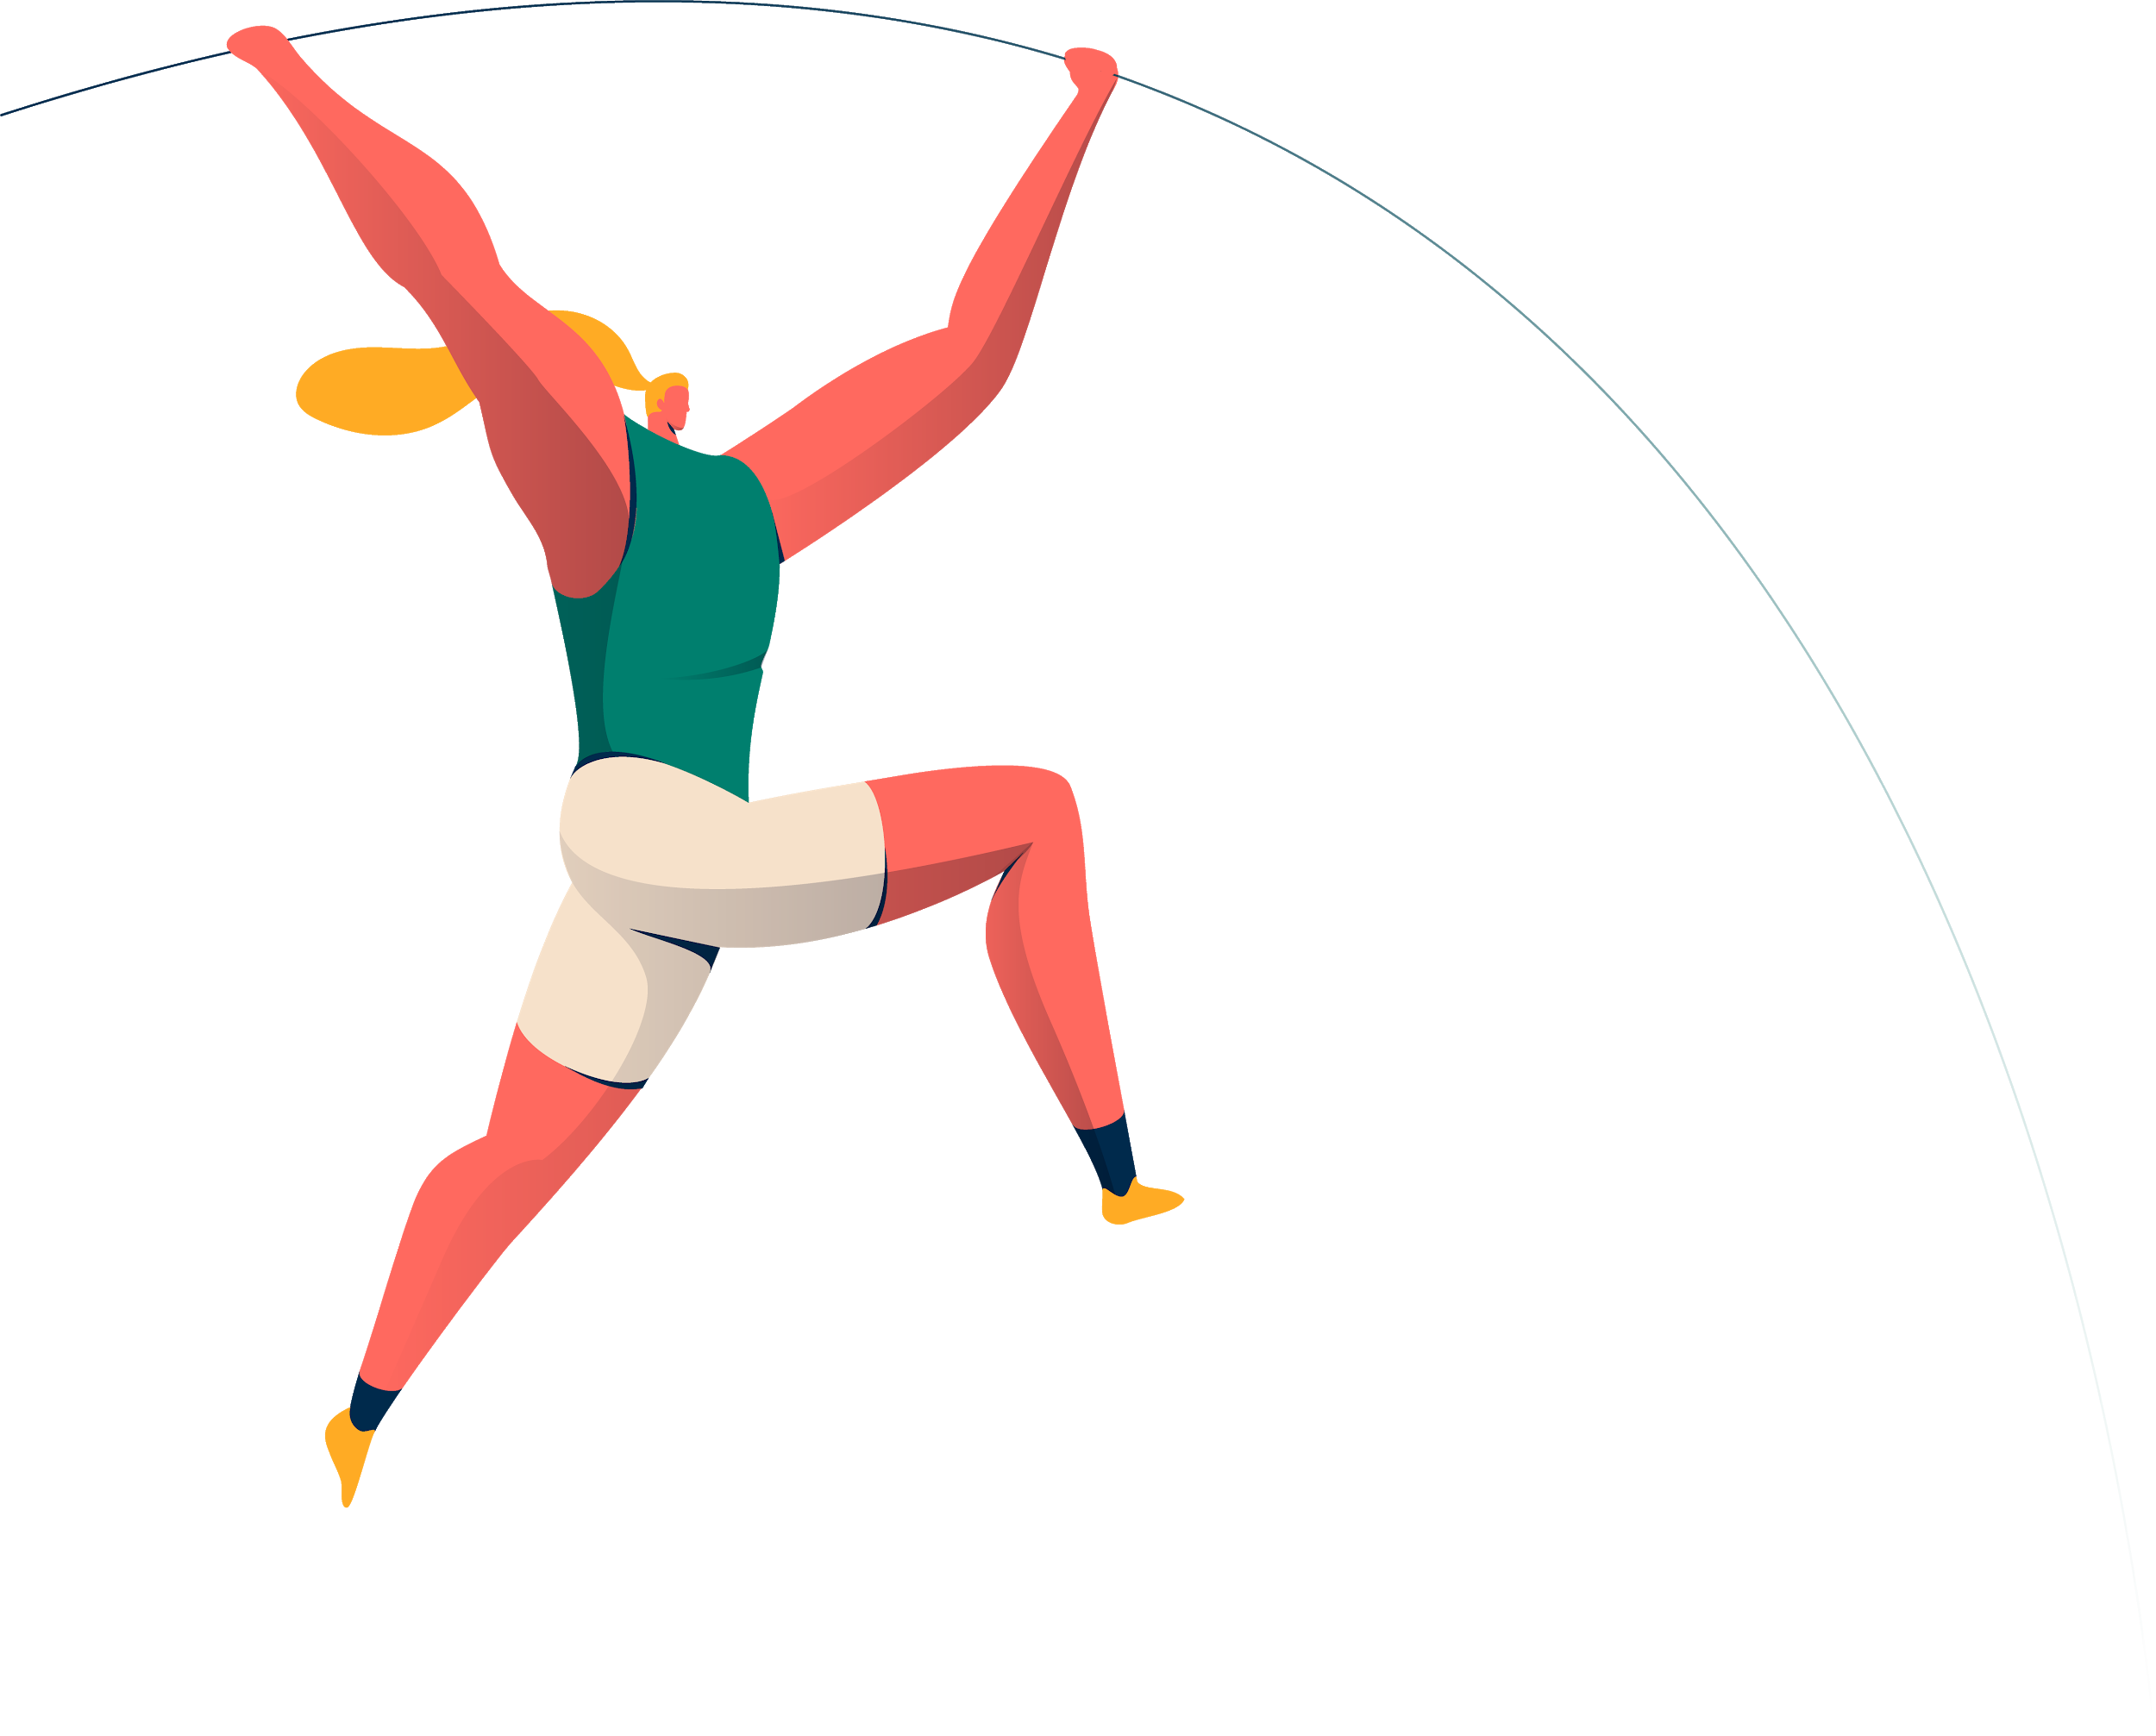
THANKS
Does anyone have any questions?
(G)Anna Serdyukova
EDCI 250 A02
B.Ed. Elementary Field Experience Seminar

Slide 20
REFERENCES
Canadian 24-hour movement guidelines for children and youth: An Integration of Physical Activity, Sedentary Behaviour, and Sleep. (n.d.). Retrieved November 24, 2020, from https://csepguidelines.ca/wp- content/themes/csep2017/pdf/Canadian24HourMovementGuidelines2016_2.pdf
Invernizzi, P., Crotti, M., Bosio, A., Cavaggioni, L., Alberti, G., & Scurati, R. (2019). Multi- Teaching Styles Approach and Active Reflection: Effectiveness in Improving Fitness Level, Motor Competence, Enjoyment, Amount of Physical Activity, and Effects on the Perception of Physical Education Lessons in Primary School Children. Sustainability, 11(2), 405. doi:10.3390/su11020405
James F. Sallis , Thomas L. McKenzie , Bohdan Kolody , Michael Lewis, Simon Marshall & Paul Rosengard (1999). Effects of Health-Related Physical Education on Academic Achievement: Project SPARK, Research Quarterly for Exercise and Sport,70:2, 127-134, doi: 10.1080/02701367.1999.1060803
Morgan, P. J., & Hansen, V. (2008). Physical education in primary schools: Classroom teachers’ perceptions of benefits and outcomes. Health Education Journal, 67(3), 196–207. https://doi.org/10.1177/0017896908094637
Petrie, K. (2010). Creating confident, motivated teachers of physical education in primary schools. European Physical Education Review, 16(1), 47–64. https://doi.org/10.1177/1356336X10369200
Physical Literacy Programs. (2020). Teacher Mentorship Program Kindergarten. Physical Literacy Programs.

Slide 21
CREDITS
Slideshow:
Presentation template by Slidesgo
Icons by Flaticon
Infographics by Freepik
Images created by Freepik
Author introduction slide photo created by Freepik
Text & Image slide photo created by Freepik.com

